Slide 1
Early Detection of Alzheimer’s disease: A Review
Ramin Nourizadeh

Slide 2
Table of Contents
Introduction
EEG
Evaluation Methods
Methods
Conclusion
Future Works

Slide 3
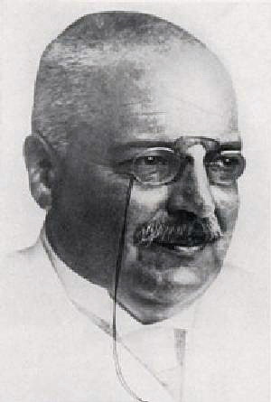
Introduction
AD
Alois Alzheimer
Notes:
Alois Alzheimer (1864 –1915) was a German psychiatrist and neuropathologist

Slide 4
Introduction
Stages Of Disease:
Normal
Very Mild Dementia
Mild Dementia
Moderate Dementia
Severe Dementia
Notes:
probability of Aβ positivity of up to 0.75 for patients with MCI and of 0.60 for SCD subjects
approximately 15–20% of MCI patients progressing to AD each year
Very Mild Dementia: Cognitive decline is noticeable but does not interfere with daily activities.
Mild Dementia: Cognitive decline is noticeable and begins to interfere with daily activities.
Moderate Dementia: Cognitive decline is significant and interferes with daily activities such as dressing and bathing.
Severe Dementia

Slide 5
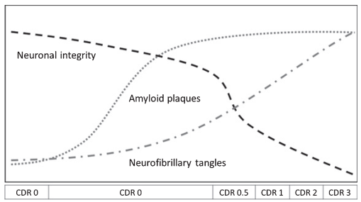
Introduction
AD diagnosis methods
Amyloid-beta (Aβ)
Begins up to 20 years
Notes:
Clinical Dementia Rating

Slide 6
Introduction
Alzheimer
30% of people are misdiagnosed
Mentioning the type of MCI
aMCI affects the hippocampus and is detectable in MRI while it is not easy for naMCI.
naMCI via an EEG-based biomarker can be more valuable
Notes:
MCI همیشه به زوال عقل منجر نمی‌شود، بلکه گاهی اوقات ثابت می‌ماند یا حتی زمانی که فرد به شرایط طبیعی خود بازگشت، علائم آن از بین می‌رود. متخصصان اختلال شناختی خفیف را به دو نوع "aMCI" و "naMCI" تقسیم کردند. نوع اول به اختلالی گفته می‌شود که بر حافظه اثر می‌گذارد، در حالی که نوع دیگر ، توانایی‌های ذهنی را تحت تاثیر قرار می‌دهد. موضوع قابل توجه اینکه aMCI، خطر ابتلا به بیماری آلزایمر را بیشتر از نوع دیگر افزایش می‌دهد.

Slide 7
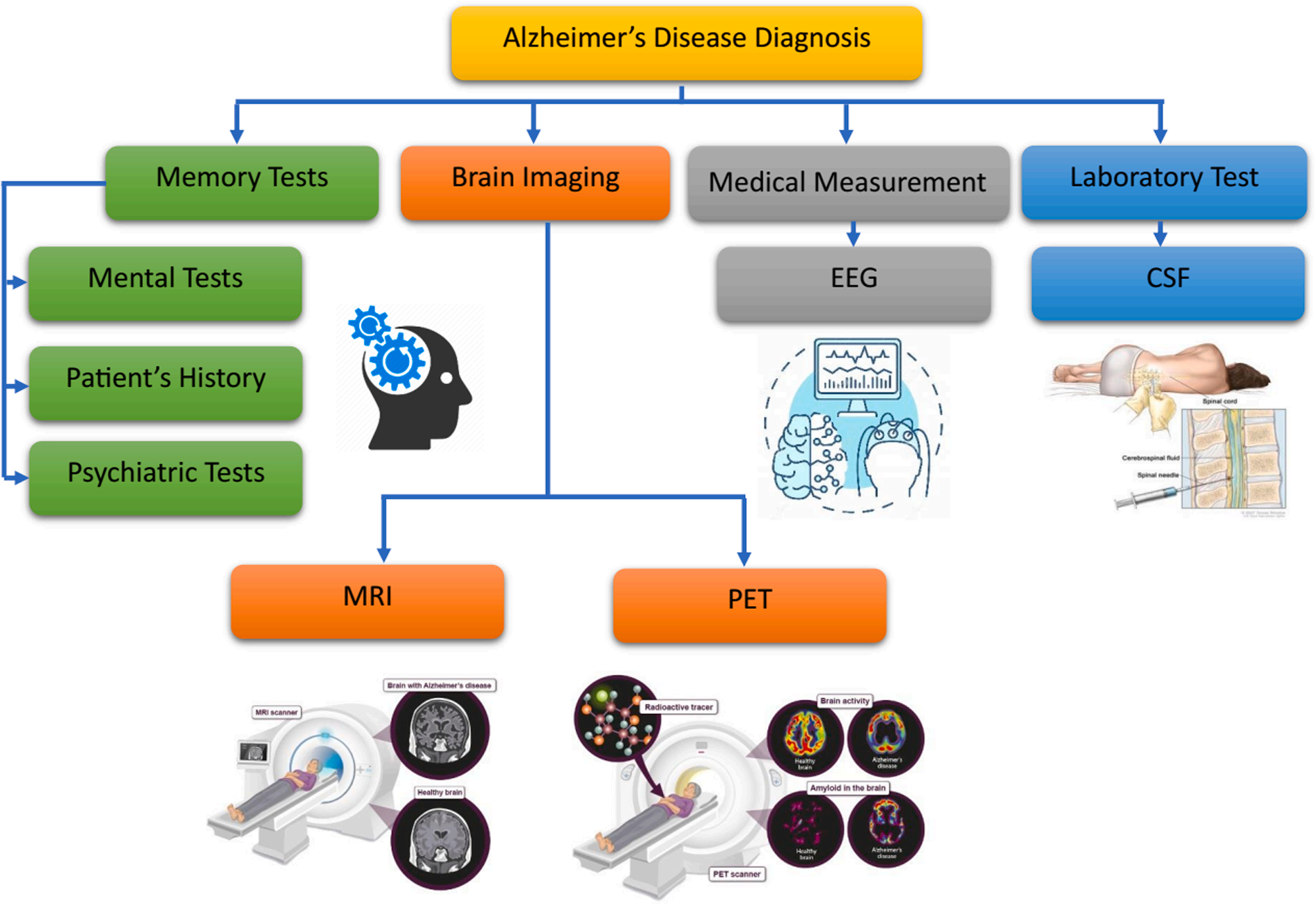
Introduction
AD diagnosis methods
Notes:
A **SPECT scan** is a type of imaging test that uses a radioactive substance and a special camera to create 3D pictures

Slide 8
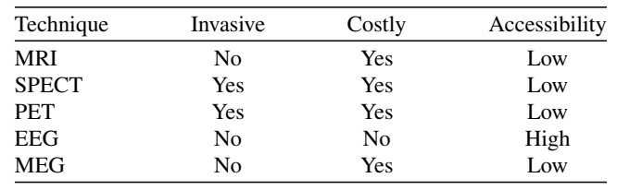
Introduction
AD diagnosis methods
Comparison of the medical techniques

Slide 9
Introduction
AD diagnosis methods
Medical imaging techniques
Voxels and features are extracted
EEG is processed in the time and the frequency domains.
MRI, CT, and PET, EEG recording methods provide good temporal resolution

Slide 10
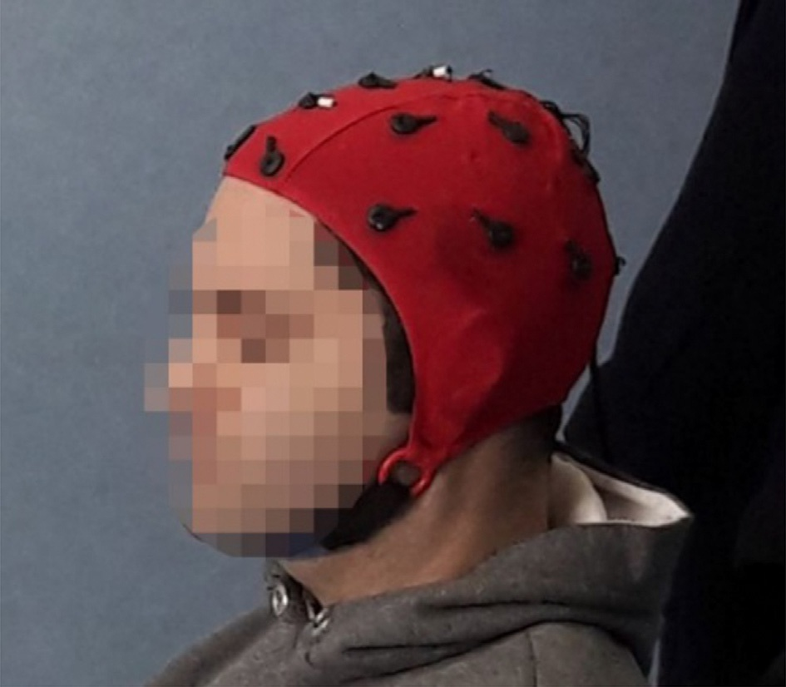
EEG
Electroencephalography signals (EEG)
Detecting electrical activity in the brain
Notes:
The distances between adjacent electrodes are either 10% or 20% of the total front-back (nasion-inion) or right-left distance of the skull. large interelectrode distance.

Slide 11
EEG
EEG Disadvantages :
Noisy raw data
Low spatial resolution
Artifacts
Power line, bad electrode contact and broken electrodes
Eye movements, muscle activity, and cardiac signals

Slide 12
EEG
Stages:
Data acquisition
Signal denoising
Feature extraction
Classification.

Slide 13
EEG
200 Hz
In a 10-min eye-closed resting state
Participants were required to remain awake during the entire recording
Capture neural events in milliseconds
spatial resolution is limited by the number of electrodes
Notes:
200 Hz refers to the sampling rate at which electrical activity in the brain is measured . It means that **200 samples per second

Slide 14
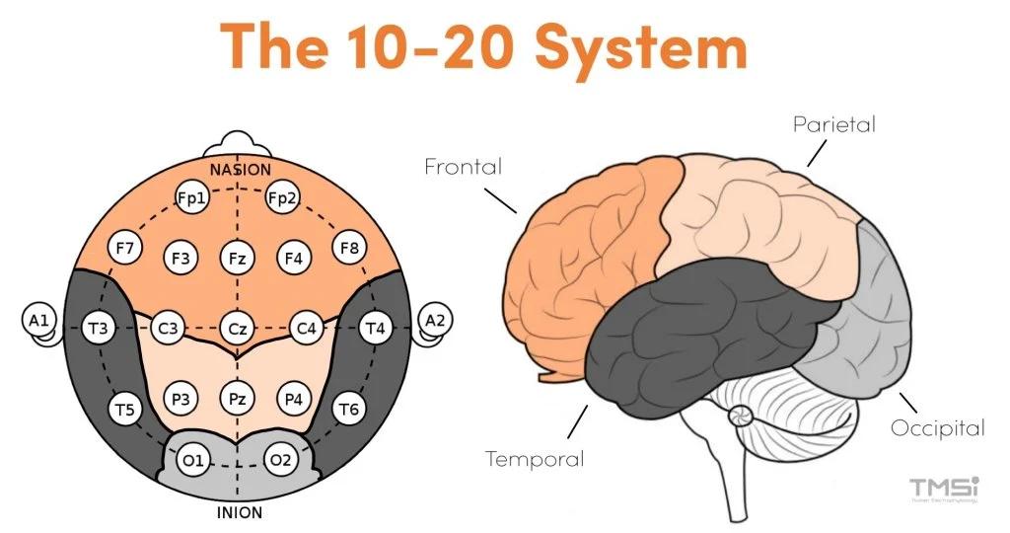
EEG
Recording
Notes:
The distances between adjacent electrodes are either 10% or 20% of the total front-back (nasion-inion) or right-left distance of the skull. large interelectrode distance.

Slide 15
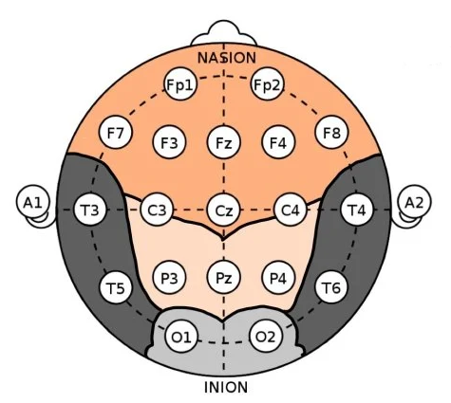
EEG
Recording
Notes:
The distances between adjacent electrodes are either 10% or 20% of the total front-back (nasion-inion) or right-left distance of the skull. large interelectrode distance.

Slide 16
EEG
Recording
Notes:
The distances between adjacent electrodes are either 10% or 20% of the total front-back (nasion-inion) or right-left distance of the skull. large interelectrode distance.

Slide 17
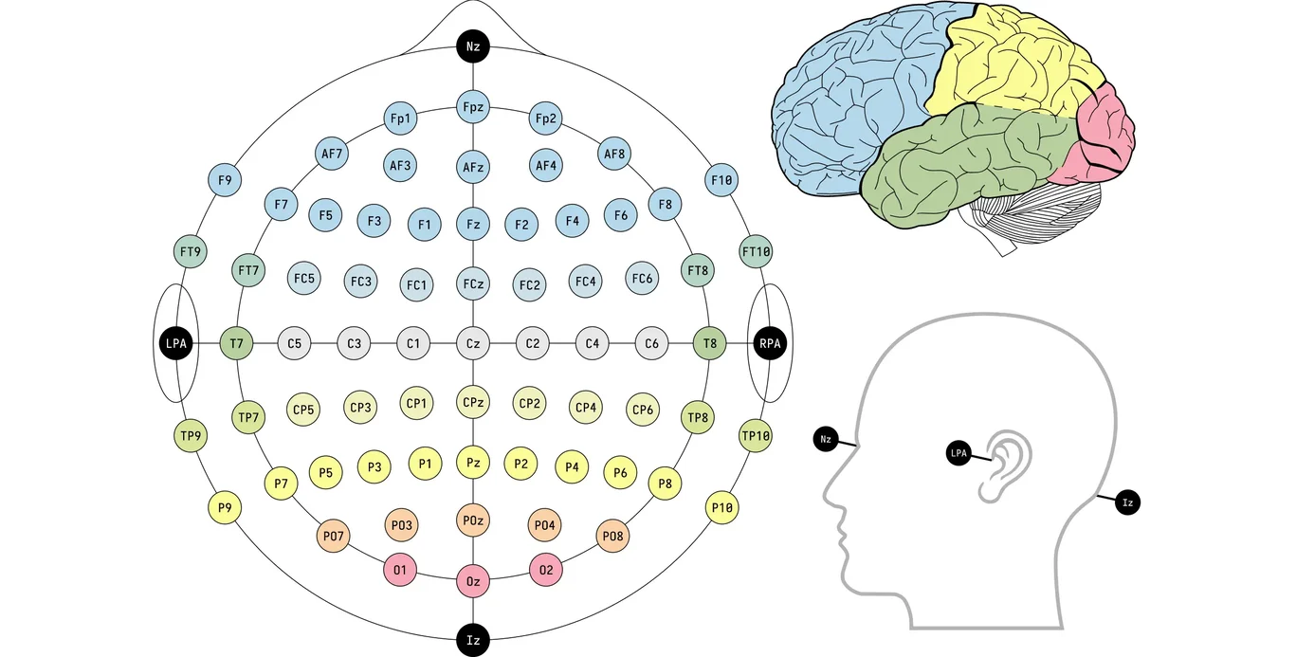
EEG
Recording
10-10 system

Slide 18
EEG
Recording

Slide 19
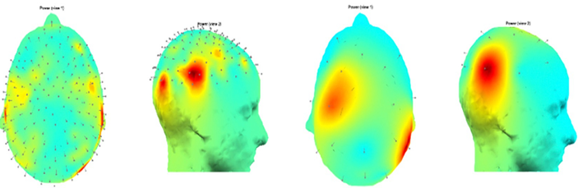
EEG
Recording
3D scalp topography of the power of the EEG recording is shown

Slide 20
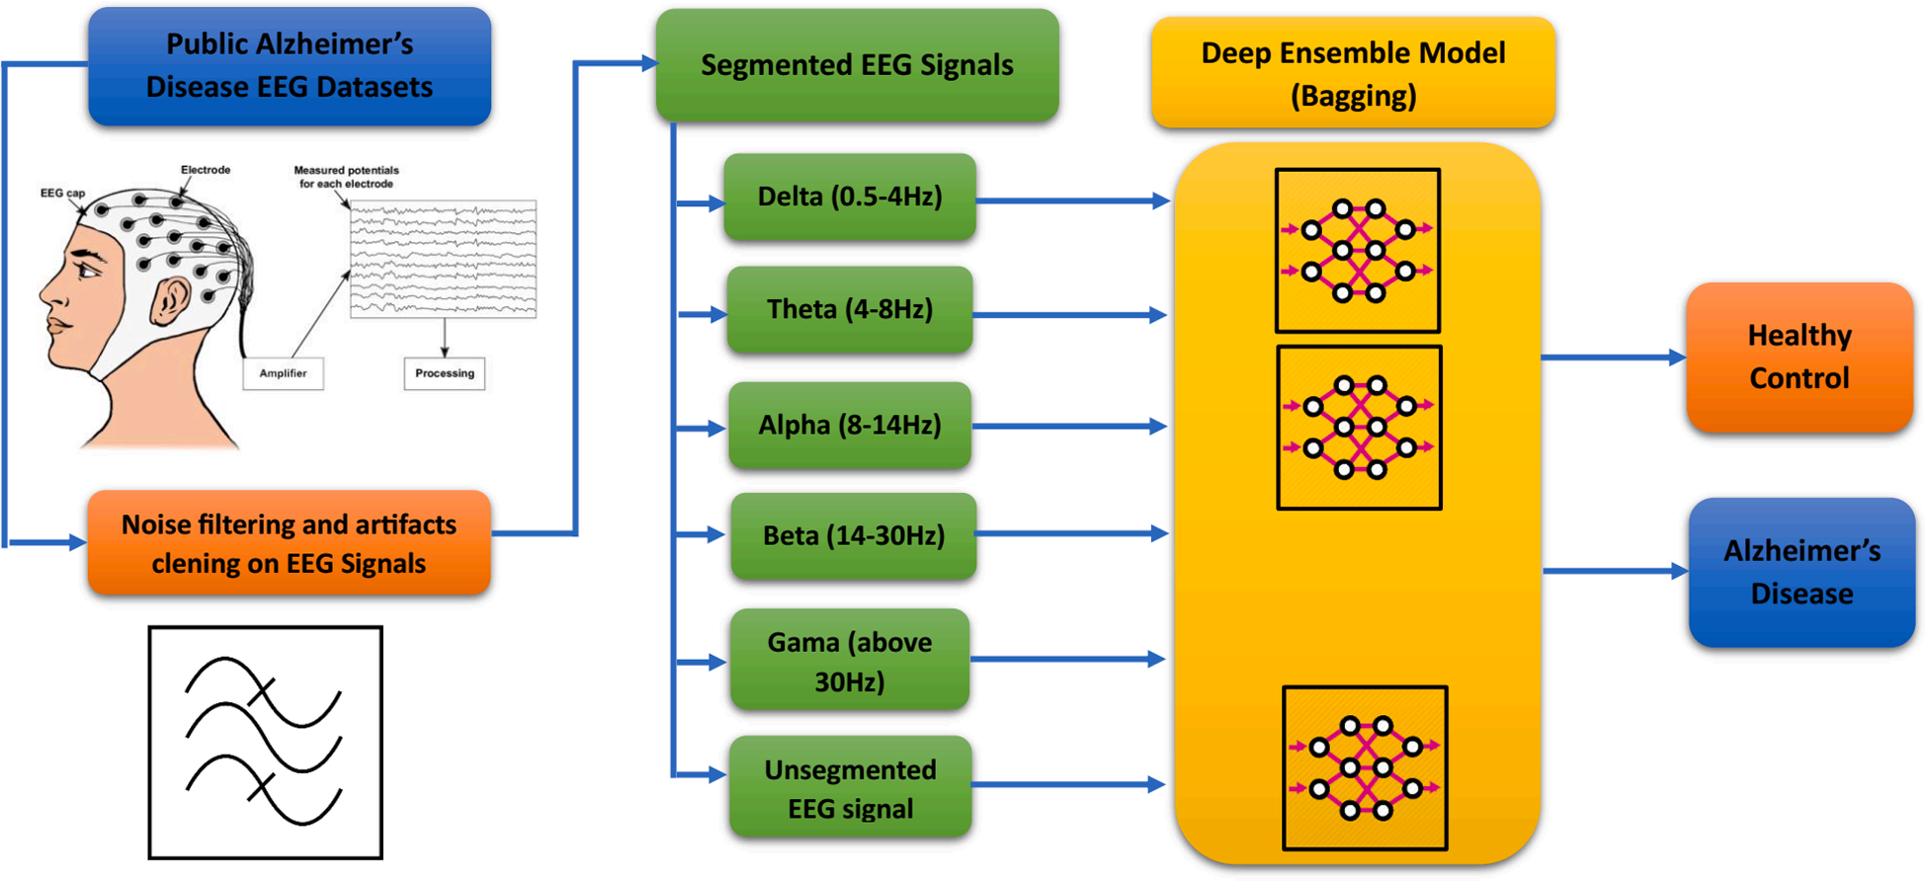
EEG
Processing
AD diagnosis model

Slide 21
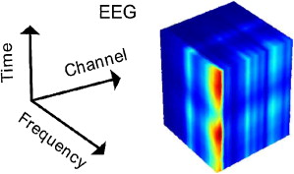
EEG
Preprocessing
Filtering and EEG rhythm calculation
Artifact reduction algorithms
Expert supervision
Data reduction
Source localization
Data augmentation
Normalization, and input generating for Deep Neural Network (DNN)

Slide 22
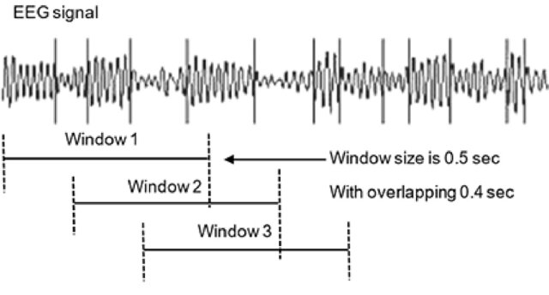
EEG
Preprocessing
Determining of the window size
Notes:
last procedure in the pre-processing stage is determining of the window size . It should be long enough to be informative about the dynamic of the system and fulfill the processing method. Long processing windows, on the other hand, can increase the computational cost. Therefore, finding a fit window size is an art.

Slide 23
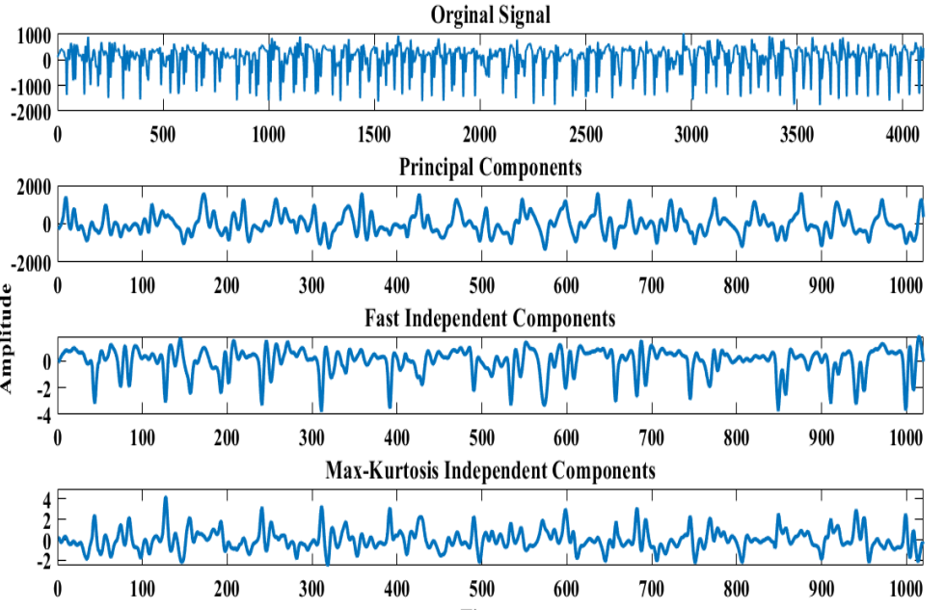
EEG
Preprocessing
Dimension reduction

Slide 24
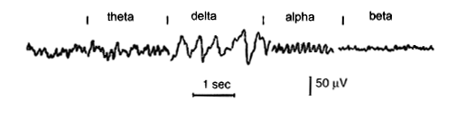
EEG
Preprocessing
Delta: has a frequency of 3 Hz or below
Theta: has a frequency of 3.5 to 7.5 Hz
Alpha: has a frequency between 7.5 and 13 Hz
Beta: : has a frequency between 13 and 25 Hz

Slide 25
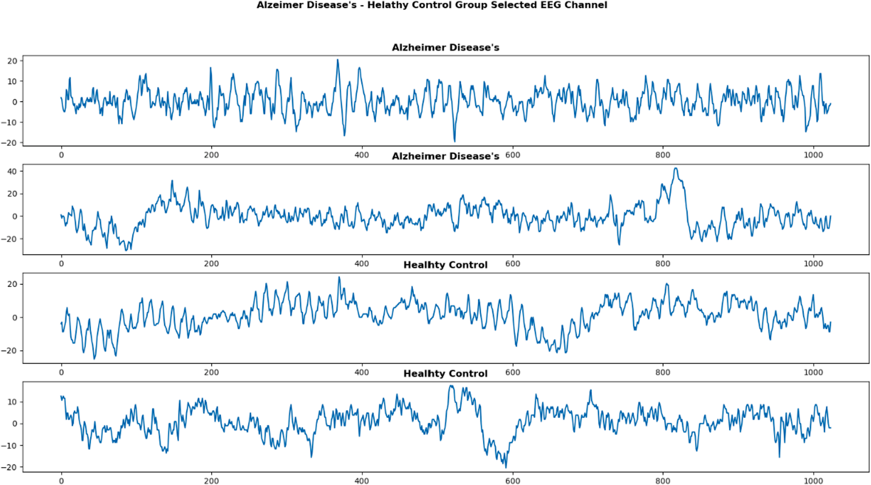
EEG
Processing
Notes:
Alzheimer Disease’s (AD) – Healthy Control (HC) Group EEG signals.

Slide 26
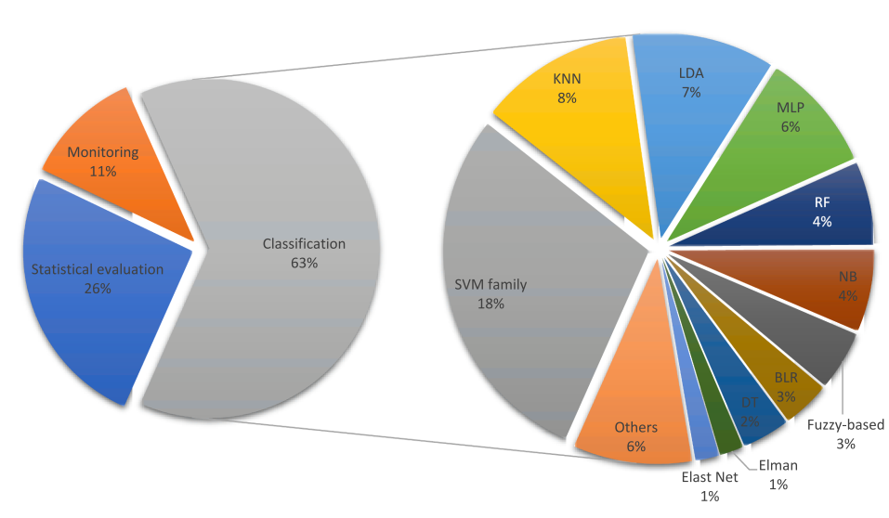
EEG
Overview of Studies
Pie chart of the percentages of Decision-making approaches
Notes:
Abbreviations: Support Vector Machine (SVM), K-Nearest Neighbor (KNN), Linear Discriminant Analysis (LDA), Multilayer Perceptron (MLP), Random Forest (RF), Naïve Bayse (NB), Binary Logistic Regression (BLR), Decision Tree (DT)

Slide 27
EEG
Feature Extraction
Transformed to the frequency domain using
Fourier methodology such as Fast Fourier Transform (FFT)
Welch Power Spectral Density (PSD) analysis
Transformed to the time-frequency domain using decomposition such as
Discrete Wavelet Transform (DWT) **
Empirical Mode Decomposition (EMD)
Notes:
Almost all the studies have employed band pass filter or discrete wavelet transform (DWT) to remove some artifacts that lie in a limited frequency band or specific artifacts
right choice of the feature selection method removed up to 82% of the EEG spectral features and increased the accuracy of the classifier more than 17%

Slide 28
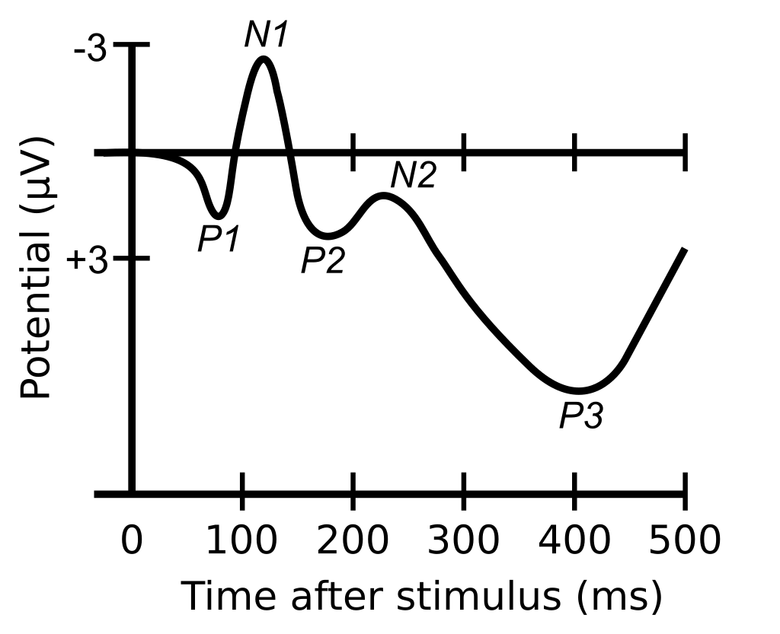
EEG
Time domain features
Event-related potentials (ERP)
ERP are electric potentials elicited in the brain as a response to an auditory or visual stimulus.
Complexity
Lower complexity and irregularity compared to HC

Slide 29
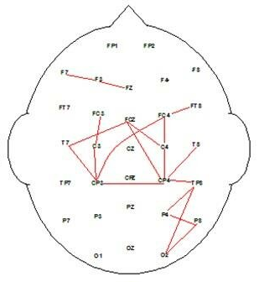
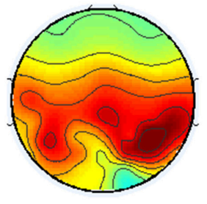
EEG
Frequency domain analysis
Coherence
This metric evaluates the synchrony between two signals
Increase of coherence in delta and theta rhythms, and a decrease in alpha and beta rhythms in MCI and AD
Relative power
This metric quantifies the proportion of power that is contained in an EEG sub band, compared to the total power of the signal.
Relative power in the fast rhythms (alpha and beta) decreases, while the relative power in the slow rhythms (delta and theta) increases.
Notes:
Coherence
This metric evaluates the synchrony between two signals. More formally, coherence refers to the normalized covariance of two signals in the spectral domain. In literature, authors have reported an increase of coherence in delta and theta rhythms, and a decrease in alpha and beta rhythms in MCI and AD
Relative power
This metric quantifies the proportion of power that is contained in an EEG sub band, compared to the total power of the signal. This means that the relative power in the fast rhythms (alpha and beta) decreases, while the relative power in the slow rhythms (delta and theta) increases.

Slide 30
EEG
Frequency domain analysis for AD detection
Fourier transform
Wavelet transform
Amplitude modulation
Combines temporal and frequency analysis
Notes:
This transform is used to decompose a time signal into a sum of sines and cosines of different frequencies and infinite length. spectral content of the EEG cannot be tracked by the Fourier transform, as the sines and cosines used in this transform are infinite length. Conversely, the

Slide 31
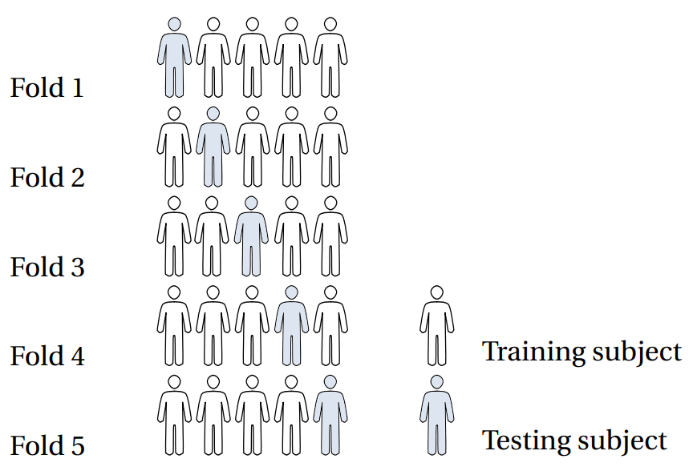
Evaluation Methods
LOSO CV (Leave-One-Out Cross-Validation)
Splitting a dataset into a training set and a testing set
Using all but one observation as part of the training set
Notes:
A model is then built using only data from the training set, and the model is used to predict the response value of the one observation left out of the model. This process is repeated n times

Slide 32
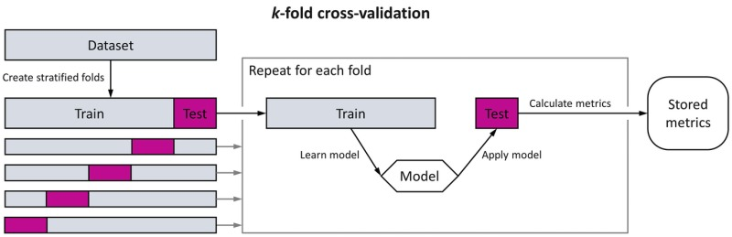
Evaluation Methods
K-fold
Dataset is randomly split into k equal-sized folds
Each fold is then used as a test set once, while the remaining k-1 folds are used as the training set
This process is repeated k times, with each fold serving as the test set exactly once.

Slide 33
Methods
Deep learning techniques in AD assessment:
Convolutional neural network (CNN)
MC-DCNN (Multi-Channel Deep Convolutional Neural Network )
Stacked autoencoder (SAE)
Spatial Temporal Convolutional Networks (ST-CNN)

Slide 34
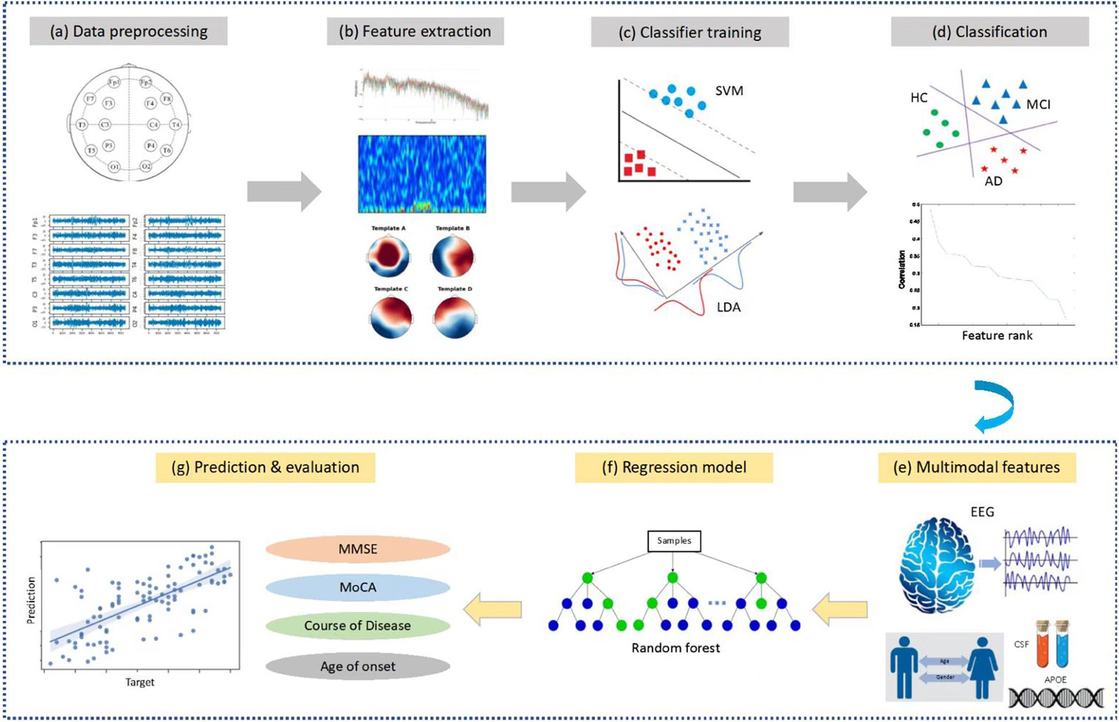
Methods
Overview
890 participants
189 MCI
330 AD
125 other dementias
246 Healthy
Jiao B, Li R, Zhou H, Qing K, Liu H, Pan H, et al. Neural biomarker diagnosis and prediction to mild cognitive impairment and Alzheimer’s disease using EEG technology. Alzheimer's Research & Therapy. 2023;15(1):32.
Notes:
Datasets are available from the corresponding author upon reasonable request

Slide 35
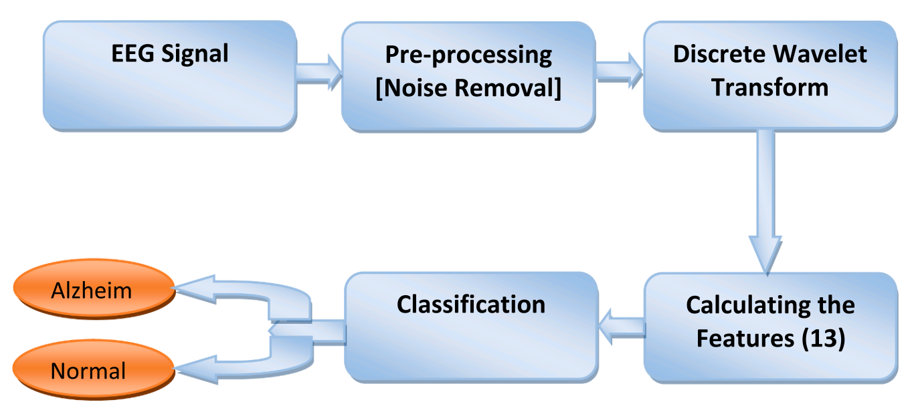
Methods
Use three central lobe electrodes
Dataset
7 MCI
59 AD
102 NC
Performance is 96.55%
Fouad IA, El-Zahraa M. Labib F. Identification of Alzheimer’s disease from central lobe EEG signals utilizing machine learning and residual neural network. Biomedical Signal Processing and Control. 2023;86.
Notes:
This EEG dataset is available as open source.

Slide 36
Methods
Using a Dual-Input Convolution Encoder Network
Public dataset from Department of Neurology of AHEPA General University Hospital of Thessaloniki
36 AD
23 Frontotemporal dementia (FTD)
29 CN
Miltiadous A, Gionanidis E, Tzimourta KD, Giannakeas N, Tzallas AT. DICE-Net: A Novel Convolution-Transformer Architecture for Alzheimer Detection in EEG Signals. IEEE Access. 2023;11:71840-58.

Slide 37
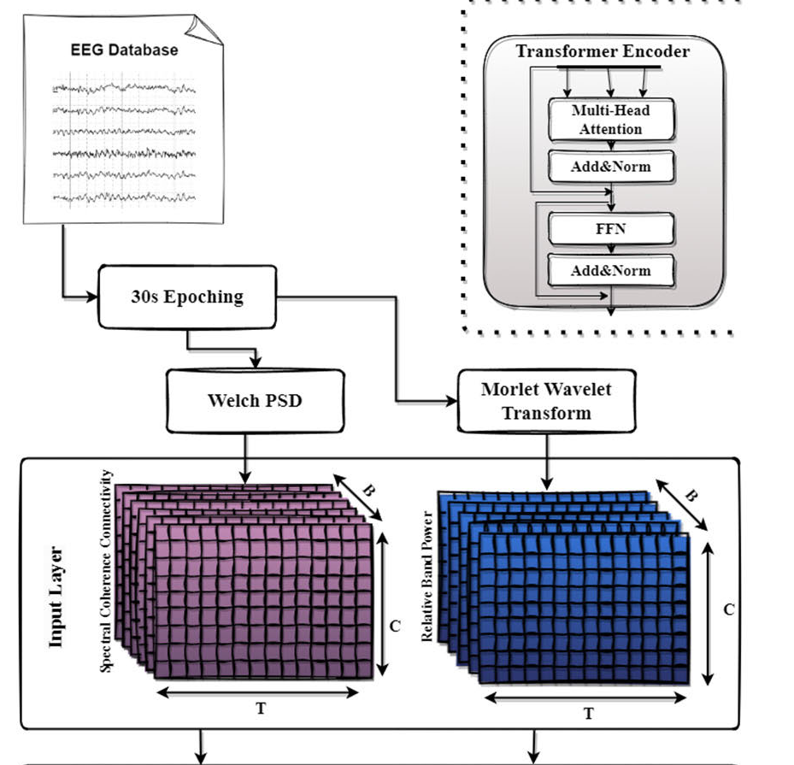
Methods
Extract two biomarkers
Relative Band Power (RBP): increase in Theta/Alpha ratio in AD patients
Spectral Coherence Connectivity (SCC): decreased synchronization likelihood in AD patients
Express them in image-like representations (3d matrixes)
Miltiadous A, Gionanidis E, Tzimourta KD, Giannakeas N, Tzallas AT. DICE-Net: A Novel Convolution-Transformer Architecture for Alzheimer Detection in EEG Signals. IEEE Access. 2023;11:71840-58.
Notes:
First, each recording was divided into 30-second time windows with 15 seconds overlap to create the pool of EEG signals that will be used for the classification task. Next, the following two features have been extracted

Slide 38
Methods
Preprocessing pipeline
Butterworth band-pass filter 0.5-45 Hz
Re-referenced to A1-A2
Automatic artifact reject method
ASR
Miltiadous A, Gionanidis E, Tzimourta KD, Giannakeas N, Tzallas AT. DICE-Net: A Novel Convolution-Transformer Architecture for Alzheimer Detection in EEG Signals. IEEE Access. 2023;11:71840-58.
Notes:
First, each recording was divided into 30-second time windows with 15 seconds overlap to create the pool of EEG signals that will be used for the classification task. Next, the following two features have been extracted

Slide 39
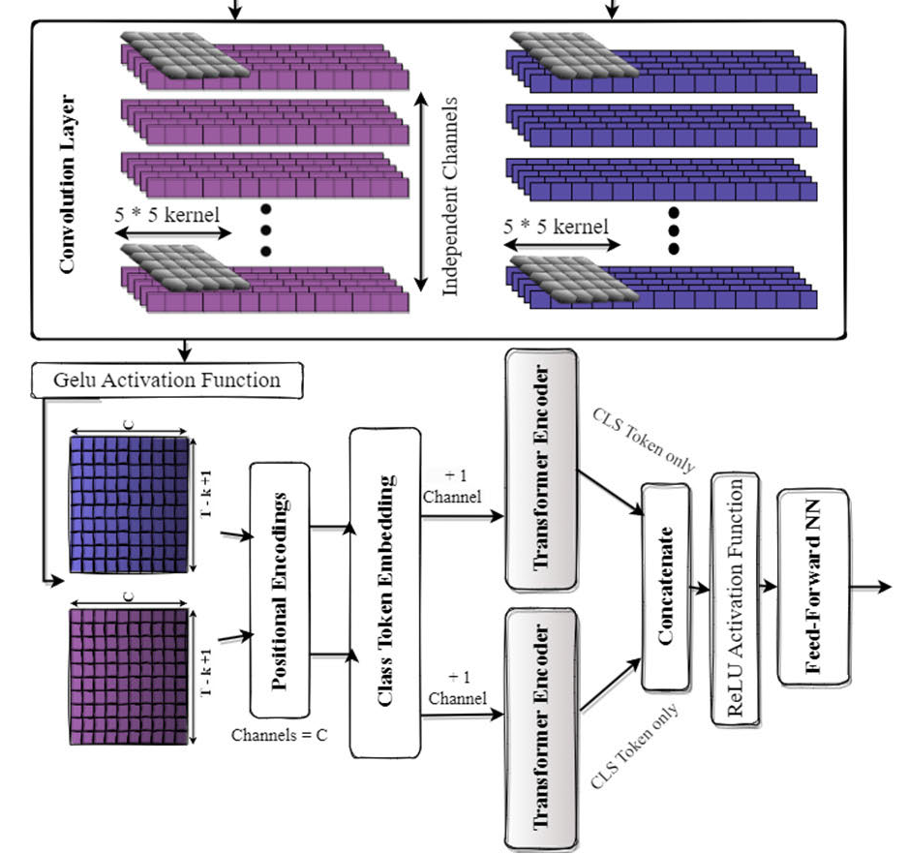
Methods
Fed in 2 parallel Convolution blocks
Accuracy of 83.28% LOSO validation
Miltiadous A, Gionanidis E, Tzimourta KD, Giannakeas N, Tzallas AT. DICE-Net: A Novel Convolution-Transformer Architecture for Alzheimer Detection in EEG Signals. IEEE Access. 2023;11:71840-58.

Slide 40
Methods
Two datasets were used
Divides EEG signals into 5 frequency bands with a Butterworth band-pass filter
Signals recorded as 8 s in the datasets were segmented into 1 s epochs
An epoch was converted into a 2D array of 128x19. A total of 1120 epochs consist of two datasets combined
Then, EEG signals for each frequency band (delta, theta, alpha, beta, and gamma) were segmented into 1 s epochs (128x19 2D array) and given as input to ensemble learning
Accuracy of 97.9%
Nour M, Senturk U, Polat K. A novel hybrid model in the diagnosis and classification of Alzheimer's disease using EEG signals: Deep ensemble learning (DEL) approach. Biomedical Signal Processing and Control. 2024;89.
Notes:
We can send the datasets at the request of the authors

Slide 41
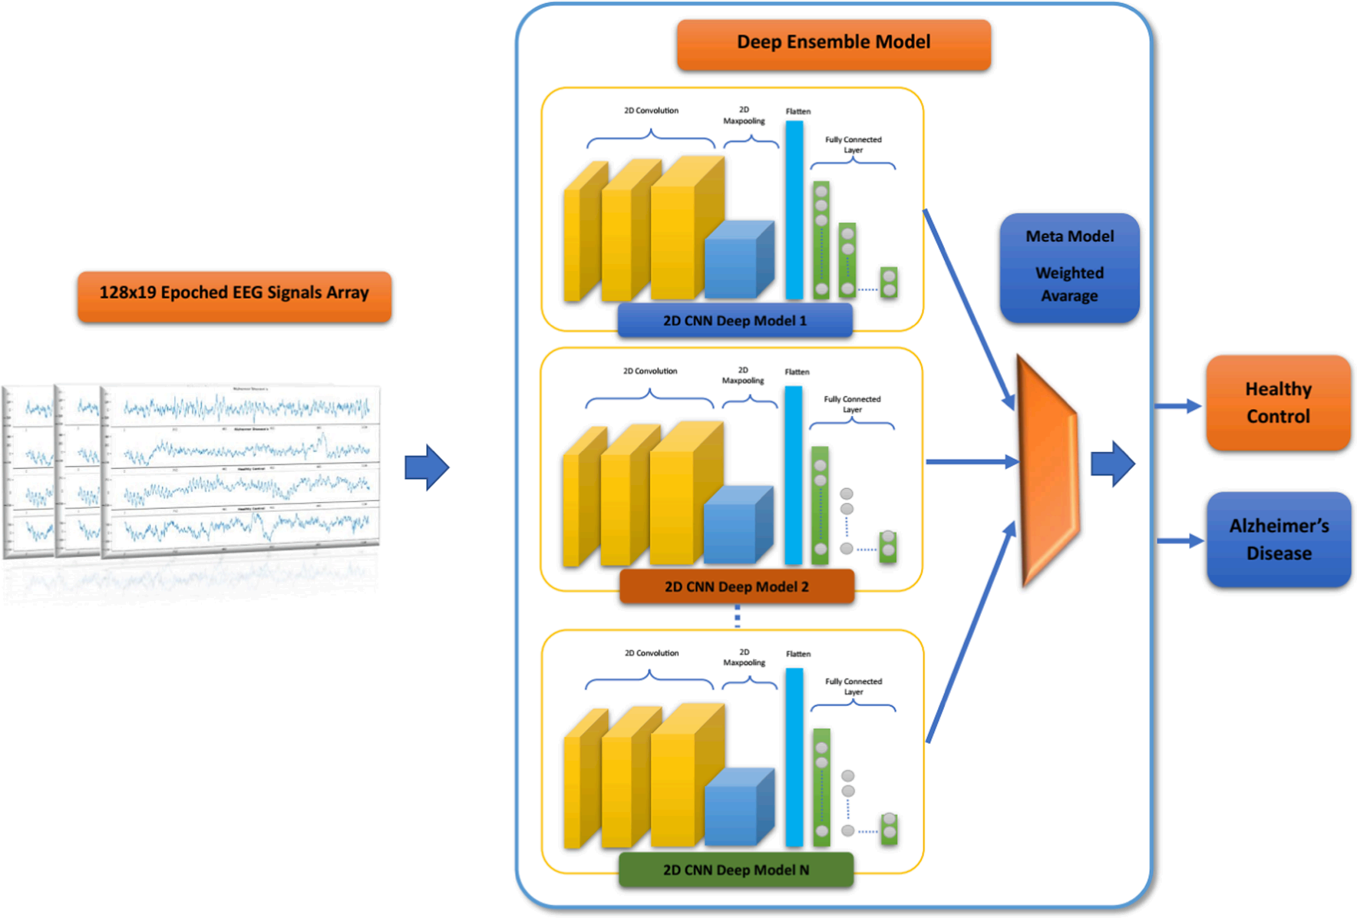
Methods
The proposed Deep Ensemble Learning
Nour M, Senturk U, Polat K. A novel hybrid model in the diagnosis and classification of Alzheimer's disease using EEG signals: Deep ensemble learning (DEL) approach. Biomedical Signal Processing and Control. 2024;89.

Slide 42
Methods
Transformers
Higher ability to deal with long-range dependencies
Recognize patterns in sequences of data
More interpretable decision-making processes
Recent efforts in exploring their applications on timeseries data, such as EEG or electromyography signals are showing interesting results
Sibilano E, Brunetti A, Buongiorno D, Lassi M, Grippo A, Bessi V, et al. An attention-based deep learning approach for the classification of subjective cognitive decline and mild cognitive impairment using resting-state EEG. Journal of Neural Engineering. 2023;20(1):016048.

Slide 43
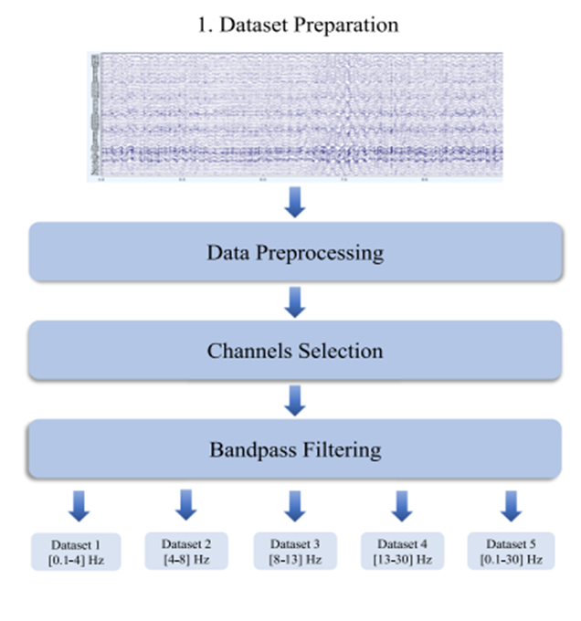
Methods
Best performances
delta dataset
Performance of 0.807
Performance with a minimum features is higher than 0.74
Adding available 61 EEG channels, instead of a cluster of 19 channels, not only did not improve the performances of the model
Sibilano E, Brunetti A, Buongiorno D, Lassi M, Grippo A, Bessi V, et al. An attention-based deep learning approach for the classification of subjective cognitive decline and mild cognitive impairment using resting-state EEG. Journal of Neural Engineering. 2023;20(1):016048.
Notes:
Five different datasets were created by extracting
delta, theta, alpha, beta and delta-to-theta frequency bands using bandpass filters

Slide 44
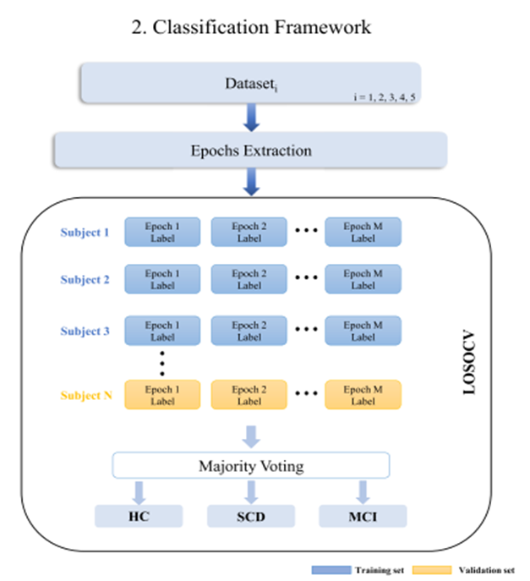
Methods
Workflow of the proposed method
Sibilano E, Brunetti A, Buongiorno D, Lassi M, Grippo A, Bessi V, et al. An attention-based deep learning approach for the classification of subjective cognitive decline and mild cognitive impairment using resting-state EEG. Journal of Neural Engineering. 2023;20(1):016048.

Slide 45
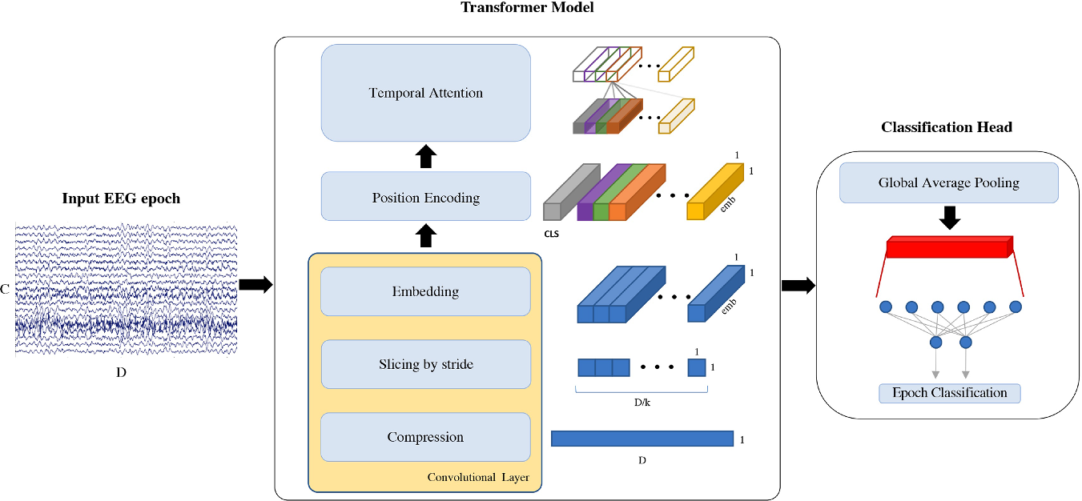
Methods
EEG epoch classification pipeline
Sibilano E, Brunetti A, Buongiorno D, Lassi M, Grippo A, Bessi V, et al. An attention-based deep learning approach for the classification of subjective cognitive decline and mild cognitive impairment using resting-state EEG. Journal of Neural Engineering. 2023;20(1):016048.
Notes:
Each EEG segment of C = 19 channels and D = 5120 datapoints is used
uses a convolutional layer to compress the signal, extract slices and embed the information. k = 31 is the size of the kernel, emb = 6 is the embeddings’ dimension and CLS is the classification token prepended to the input. Attention mechanism is then applied on the temporal domain and, after global average pooling, a linear layer is used to classify the input EEG epoch

Slide 46

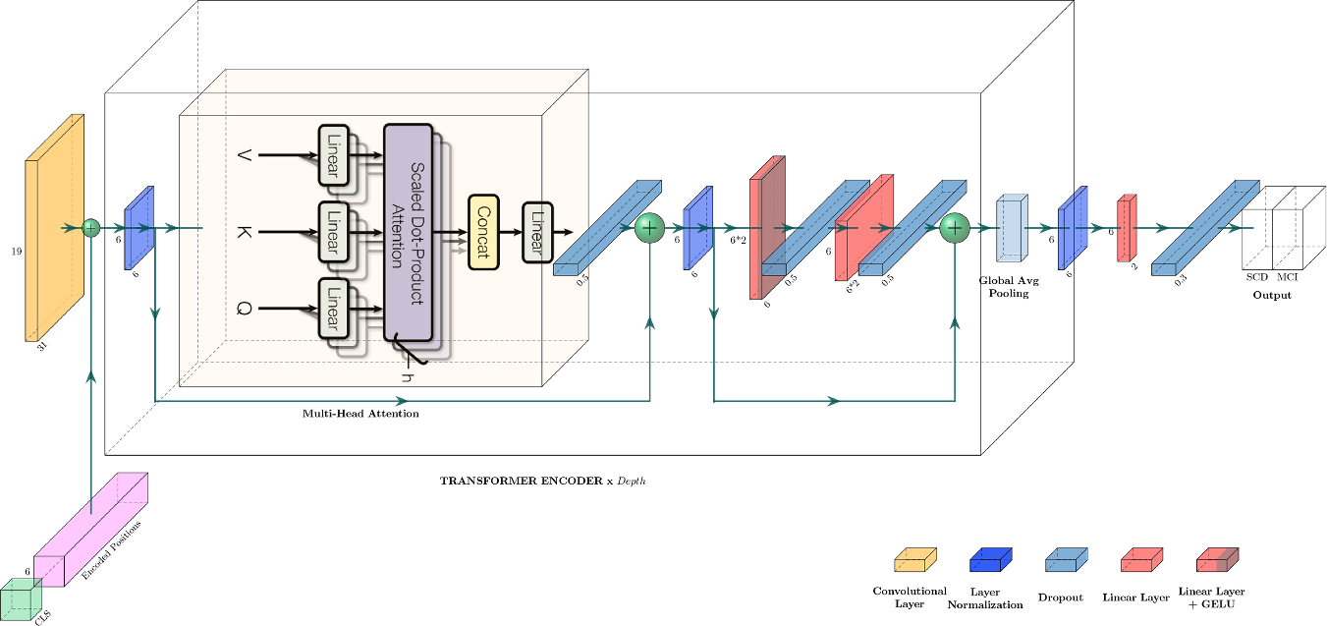
Methods
Proposed transformer architecture
Sibilano E, Brunetti A, Buongiorno D, Lassi M, Grippo A, Bessi V, et al. An attention-based deep learning approach for the classification of subjective cognitive decline and mild cognitive impairment using resting-state EEG. Journal of Neural Engineering. 2023;20(1):016048.
Notes:
CLS is the classification token, h = 3 is the number of heads used by multi-head attention and Depth = 2 indicates the number of times the transformer encoder block is repeated. A legend for uncaptioned blocks is provided on the bottom right corner

Slide 47
Methods
The 19-channel EEG recording is partitioned into N nonoverlapping 5s windows
For each EEG epoch, and for every EEG channel a time-frequency representation (TFR) is computed. The TFRs are averaged over epochs resulting in 19 averaged TFRs (one per channel). Each averaged TFR is subdivided into three sub bands, and then, the mean (μ), the standard deviation (σ), and the skewness (v) are estimated both for the sub bands and for the whole TFR.
The first autoencoder compresses the input representation in 40 parameters . The second autoencoder compresses the 40 learned features in 20 higher-level paraments
A classifier with a single hidden layer of 10 neurons is trained
Morabito, F. C., et al. (2017). "Deep Learning Representation from Electroencephalography of Early-Stage Creutzfeldt-Jakob Disease and Features for Differentiation from Rapidly Progressive Dementia." Int J Neural Syst 27(2): 1650039.

Slide 48
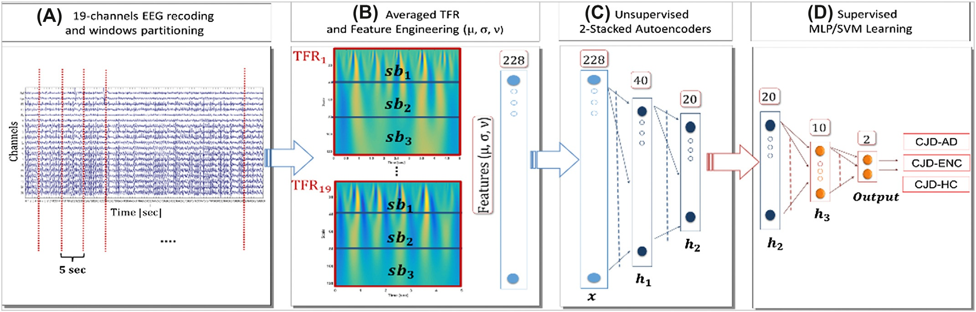
Methods
Morabito, F. C., et al. (2017). "Deep Learning Representation from Electroencephalography of Early-Stage Creutzfeldt-Jakob Disease and Features for Differentiation from Rapidly Progressive Dementia." Int J Neural Syst 27(2): 1650039.

Slide 49
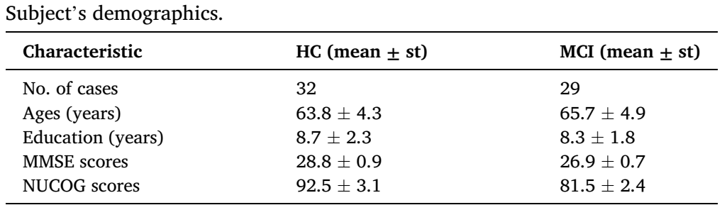
Methods
The study analyzed a total of eight EEG features obtained from 21 channels.
Used two public datasets that are both available
Aljalal, M., et al. (2024). "Mild cognitive impairment detection with optimally selected EEG channels based on variational mode decomposition and supervised machine learning." Biomedical Signal Processing and Control 87.

Slide 50
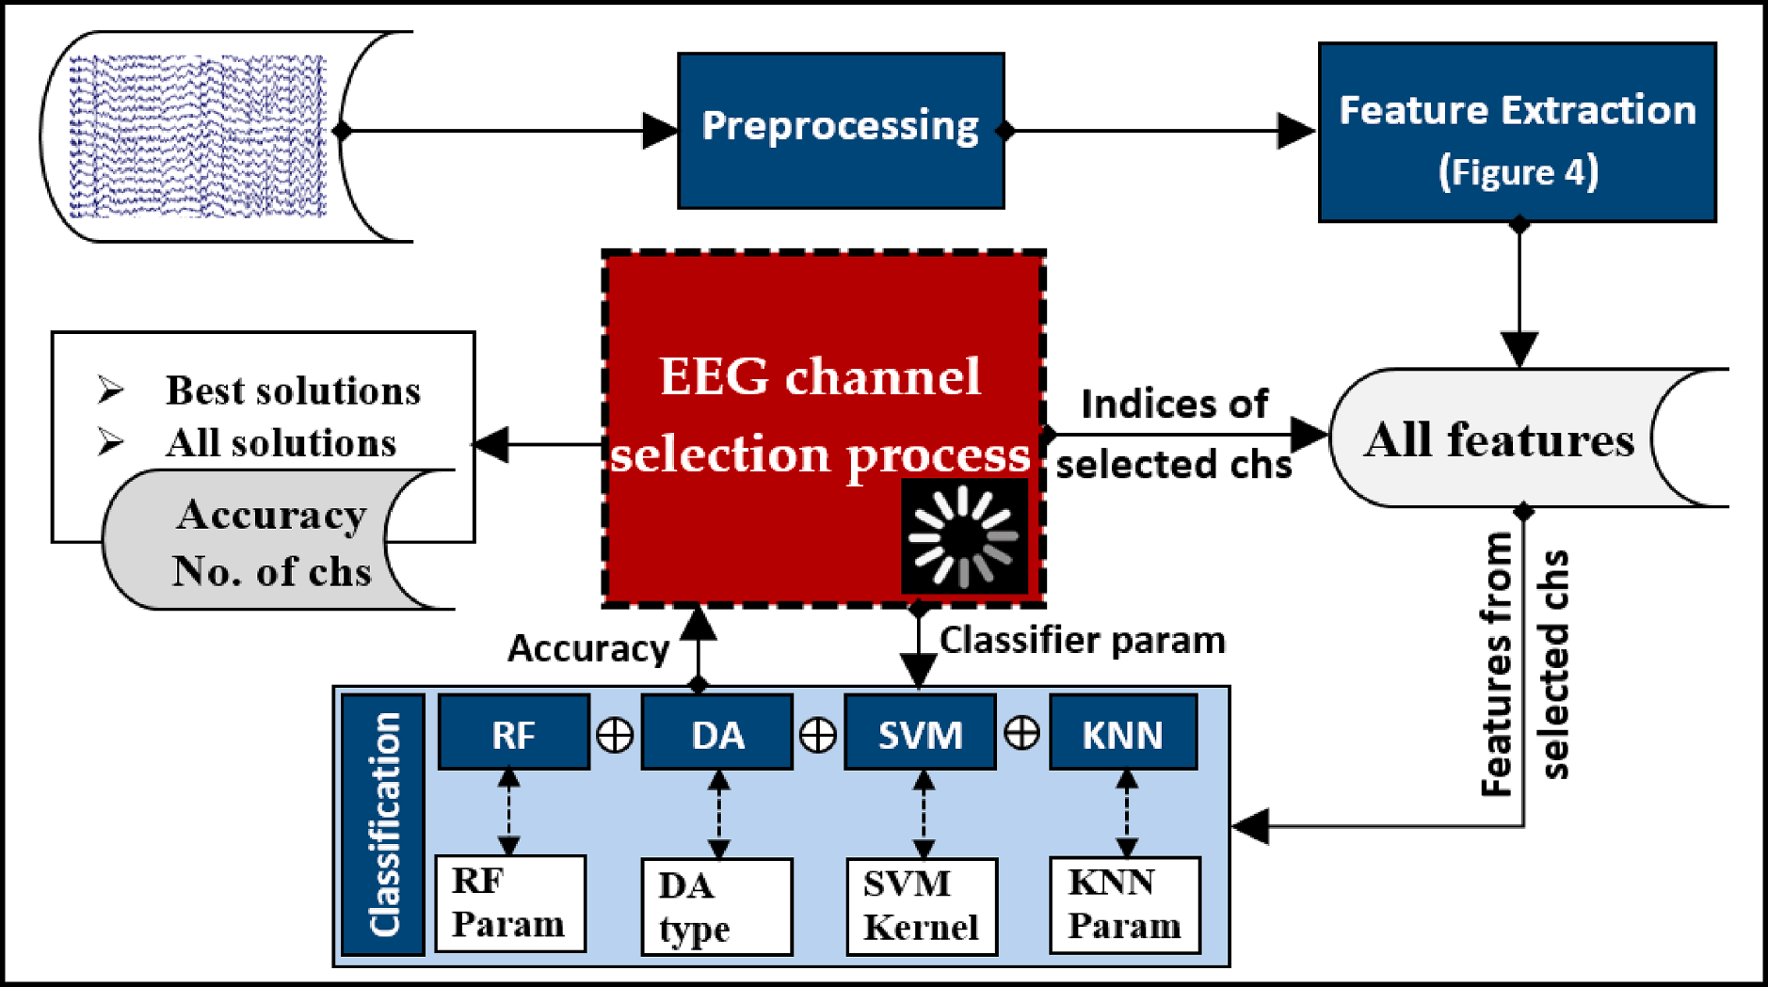
Methods
Overview
Aljalal, M., et al. (2024). "Mild cognitive impairment detection with optimally selected EEG channels based on variational mode decomposition and supervised machine learning." Biomedical Signal Processing and Control 87.

Slide 51
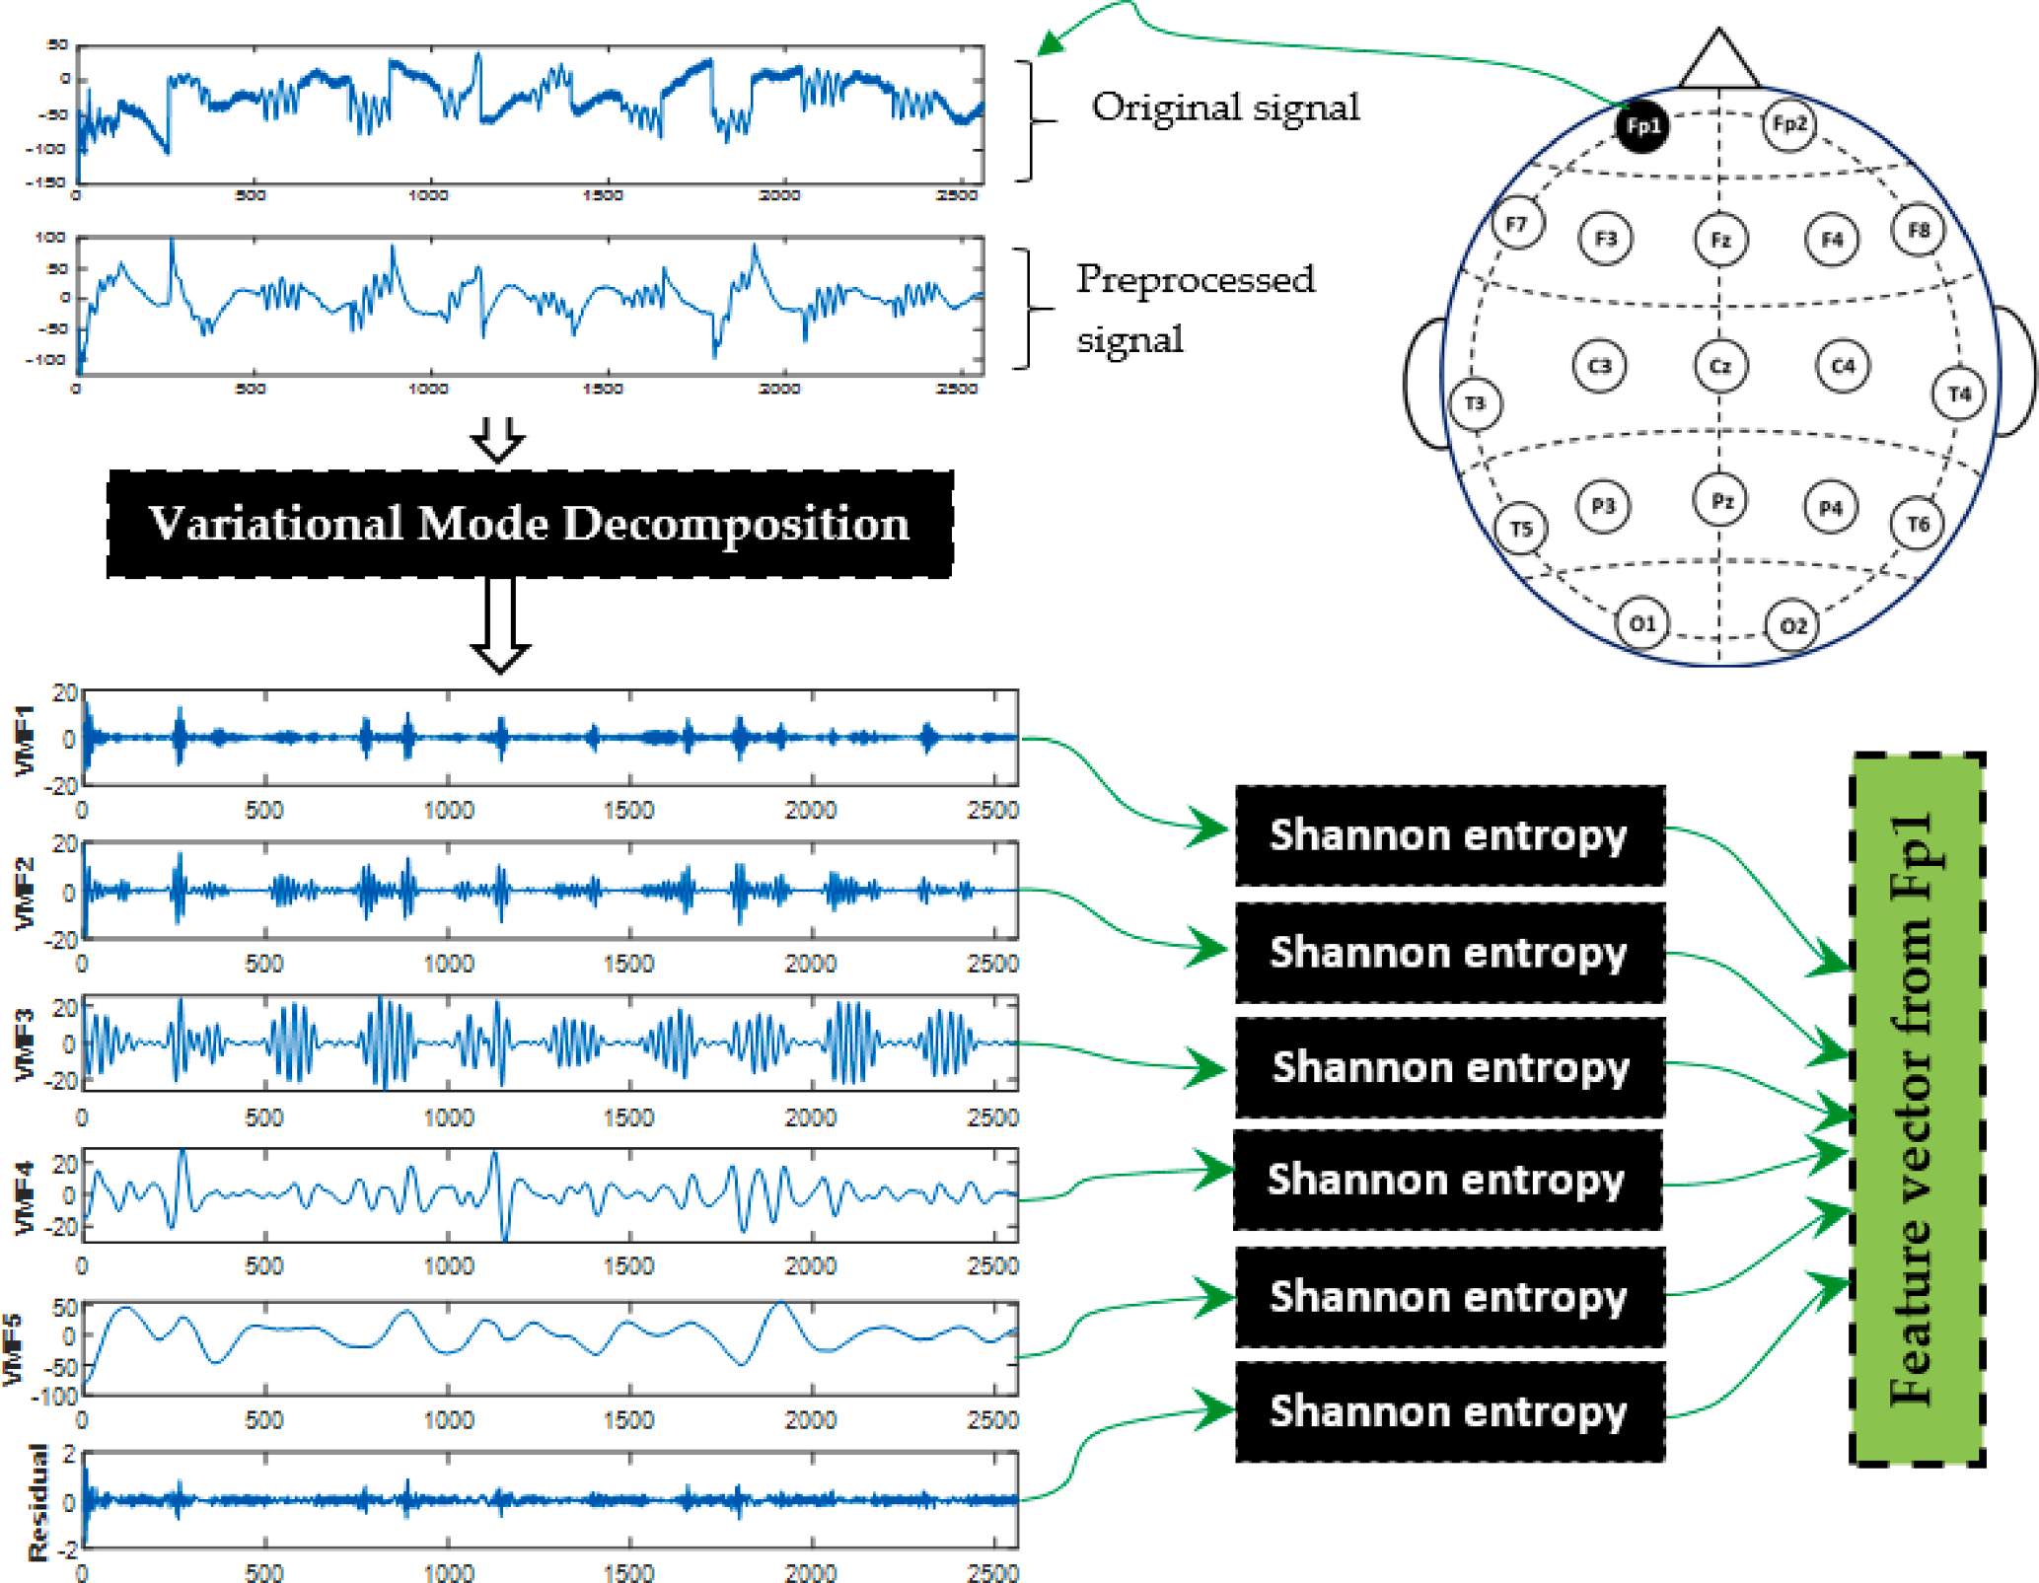
Methods
Example of feature extraction from a 10 sec segment using VMD and Shannon entropy.
Aljalal, M., et al. (2024). "Mild cognitive impairment detection with optimally selected EEG channels based on variational mode decomposition and supervised machine learning." Biomedical Signal Processing and Control 87.
Notes:
Variational Mode Decomposition (VMD) is a signal processing technique that decomposes a signal into a finite number of intrinsic mode functions

Slide 52
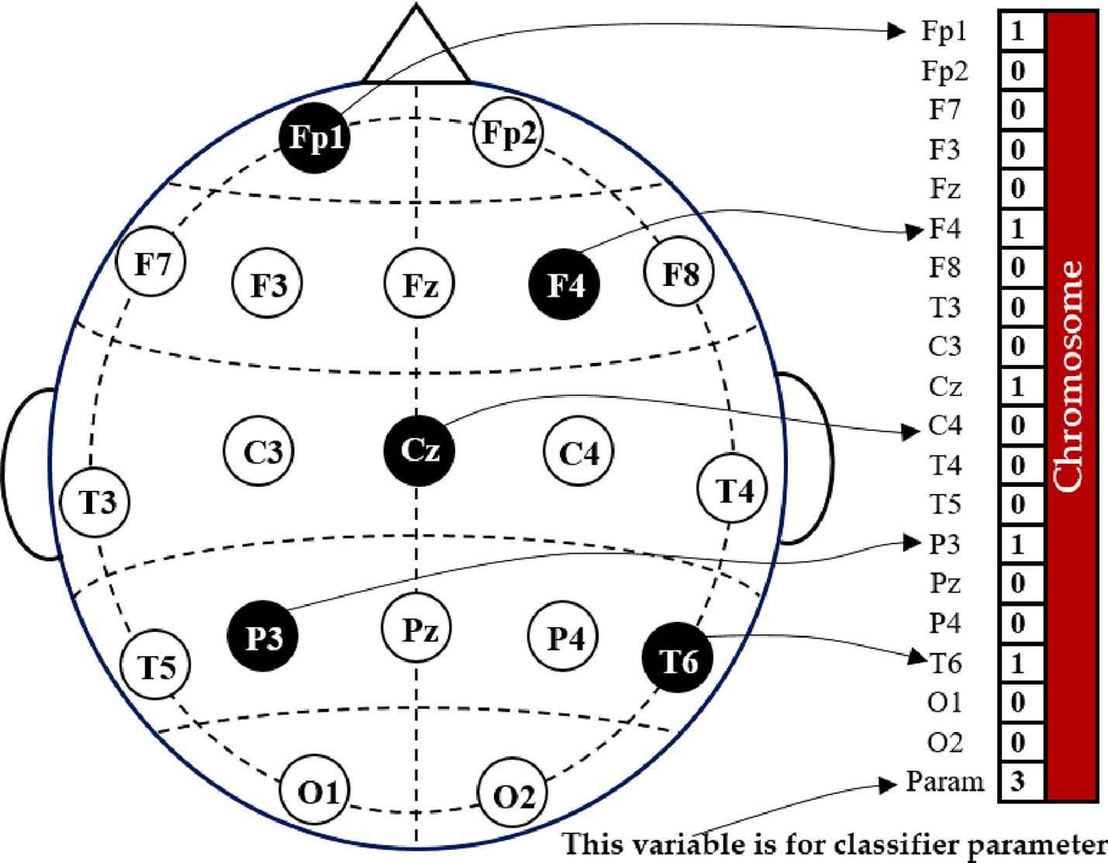
Methods
Example of channel representation in a chromosome
Aljalal, M., et al. (2024). "Mild cognitive impairment detection with optimally selected EEG channels based on variational mode decomposition and supervised machine learning." Biomedical Signal Processing and Control 87.

Slide 53
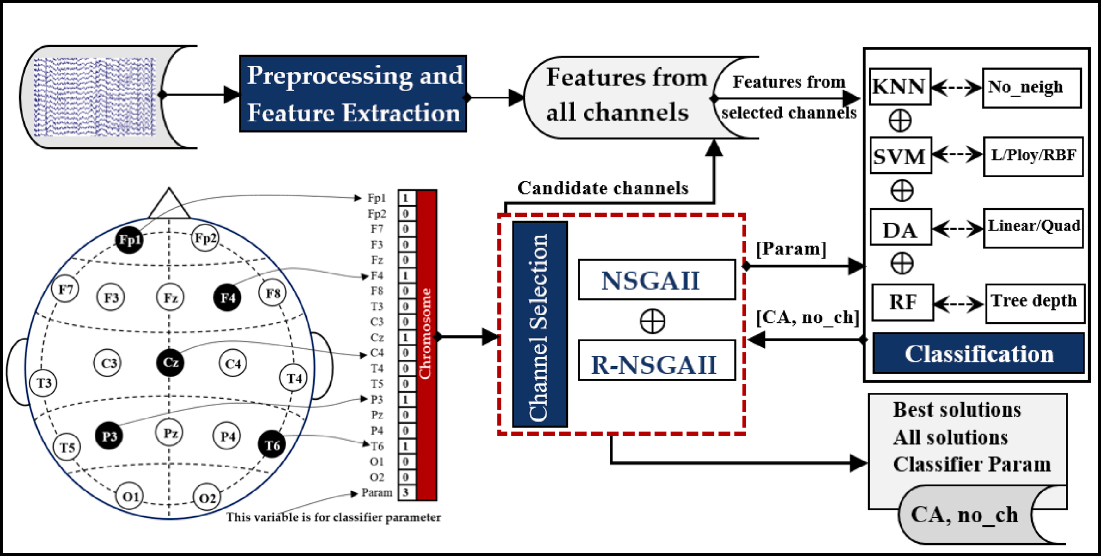
Methods
EEG channel selection using NSGA for MCI classification
Accuracy using all 19 EEG channels is 99.51%
Aljalal, M., et al. (2024). "Mild cognitive impairment detection with optimally selected EEG channels based on variational mode decomposition and supervised machine learning." Biomedical Signal Processing and Control 87.

Slide 54
Methods
EEG with a window size of 0.25 s
Independent component analysis (ICA) is applied
Bad channels are manually removed
Accuracies of 94.68% were achieved
This proves the effectiveness of the transformers for processing raw EEG data
Can reduce the need for feature extraction in EEG .
Siddhad, G., et al. (2024). "Efficacy of transformer networks for classification of EEG data." Biomedical Signal Processing and Control 87: 105488.

Slide 55
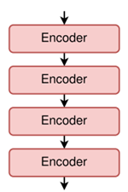
Methods
Stack of 4 encoders are used in the proposed method
Siddhad, G., et al. (2024). "Efficacy of transformer networks for classification of EEG data." Biomedical Signal Processing and Control 87: 105488.

Slide 56
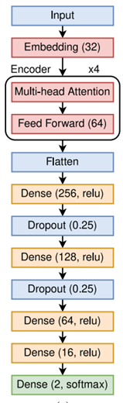
Methods
Proposed architecture for Age and Gender dataset
Siddhad, G., et al. (2024). "Efficacy of transformer networks for classification of EEG data." Biomedical Signal Processing and Control 87: 105488.

Slide 57
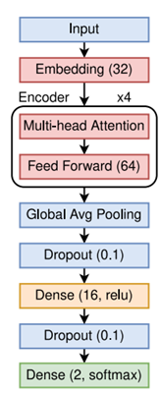
Methods
Proposed architecture for STEW dataset
Siddhad, G., et al. (2024). "Efficacy of transformer networks for classification of EEG data." Biomedical Signal Processing and Control 87: 105488.

Slide 58
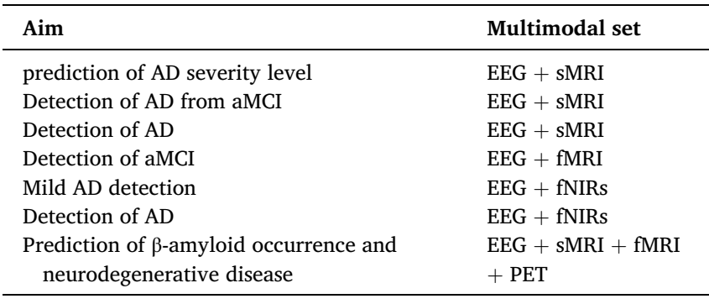
Methods
Multimodal neuroimaging system and their aim in AD assessment
Modir, A., et al. (2023). "A systematic review and methodological analysis of EEG-based biomarkers of Alzheimer's disease." Measurement 220.
Notes:
fNIR and fMRI are both neuroimaging techniques that are used to study the brain. fNIR stands for functional near-infrared spectroscopy. Both techniques are used to measure changes in blood flow in the brain, but they differ in how they do so. fMRI uses a strong magnetic field and radio waves to measure changes in blood oxygenation, while fNIR uses near-infrared light to measure changes in blood oxygenation

Slide 59
Methods
Monitoring of AD progression in large populations with few electrodes in low-cost devices
Data acquired in hospital settings (10-20 montage) from 75 ADMCI participants and 70 age-, education-, and sex-matched normal elderly controls (Nold) were available in an Italian-Turkish archive (www.pdwaves.eu).
Standard spectral fast fourier transform (FFT) analysis of rsEEG data for individual delta, theta, and alpha frequency bands was computed from 6 monopolar scalp electrodes to derive bipolar C3-P3, C4-P4,O1 and O2 markers
Tucci, F., et al. (2023). "What a single electroencephalographic (EEG) channel can tell us about Alzheimer's disease patients with mild cognitive impairment." Alzheimer's & Dementia 19(S2): e062375.

Slide 60
Methods
Tucci, F., et al. (2023). "What a single electroencephalographic (EEG) channel can tell us about Alzheimer's disease patients with mild cognitive impairment." Alzheimer's & Dementia 19(S2): e062375.

Slide 61
Methods
The ADMCI group showed increased delta and decreased alpha power density
Best classification accuracy between the ADMCI and Nold individuals reached 81% using Alpha2/Theta power density computed at the C3-P3 bipolar channel..
Tucci, F., et al. (2023). "What a single electroencephalographic (EEG) channel can tell us about Alzheimer's disease patients with mild cognitive impairment." Alzheimer's & Dementia 19(S2): e062375.

Slide 62
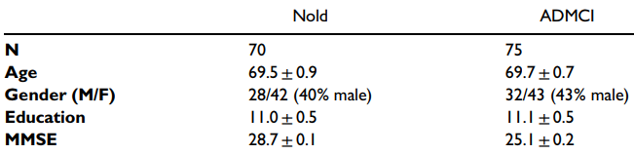
Methods
Demographic and clinical data in Nold and ADMCI
To evaluate the study hypotheses, clinical, neuropsychological, anthropometric, genetic, cerebrospinal fluid (CSF), MRI, and rsEEG data in 70 Nold and 75 ADMCI subjects from an international archive were used in the present study
Tucci, F., et al. (2023). "What a single electroencephalographic (EEG) channel can tell us about Alzheimer's disease patients with mild cognitive impairment." Alzheimer's & Dementia 19(S2): e062375.

Slide 63
Methods
Two different deep learning (DL) architectures
Modified convolutional (CNN) with accuracy 92%
Convolutional autoencoder (Conv-AE) neural networks (NNs) with accuracy 89 %
Fouladi, S., et al. (2022). "Efficient Deep Neural Networks for Classification of Alzheimer’s Disease and Mild Cognitive Impairment from Scalp EEG Recordings." Cognitive Computation 14(4): 1247-1268.

Slide 64
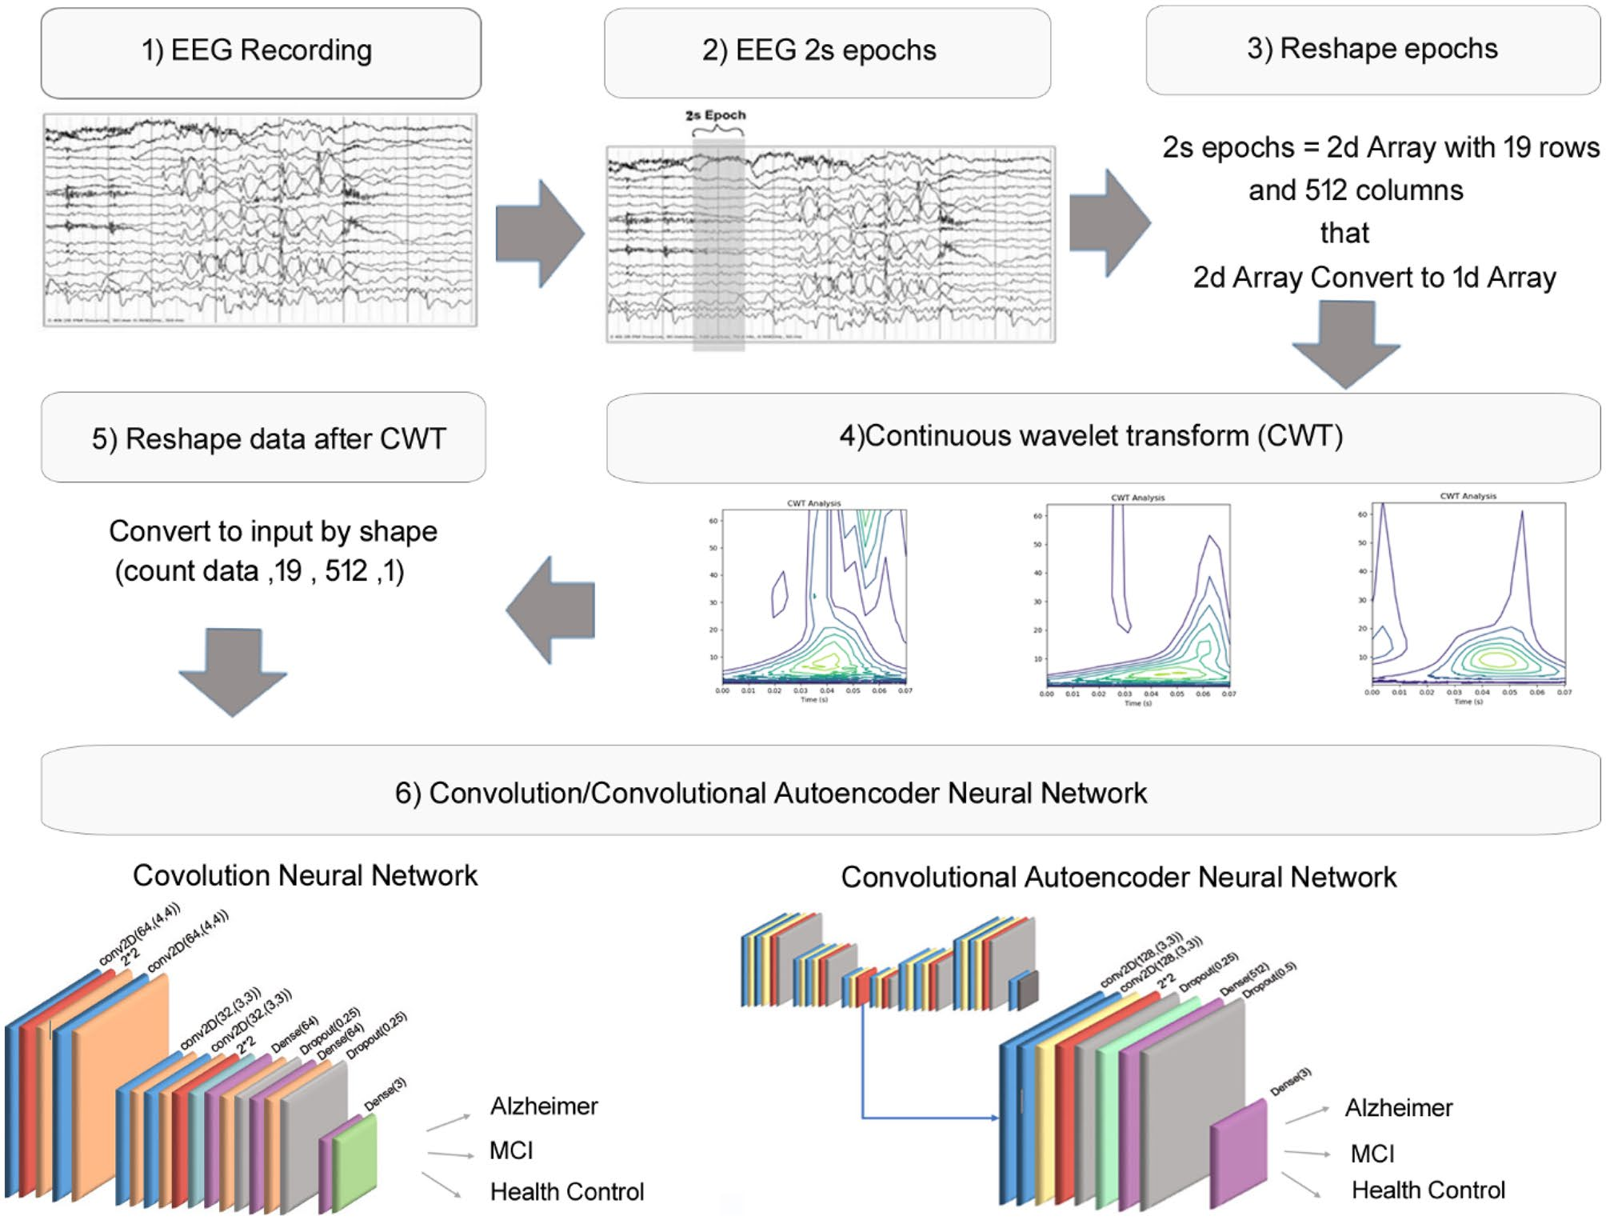
Methods
19-channel
90 subjects
37 AD
37 MCI
16 HC
Recorded in 5-m
Fouladi, S., et al. (2022). "Efficient Deep Neural Networks for Classification of Alzheimer’s Disease and Mild Cognitive Impairment from Scalp EEG Recordings." Cognitive Computation 14(4): 1247-1268.

Slide 65
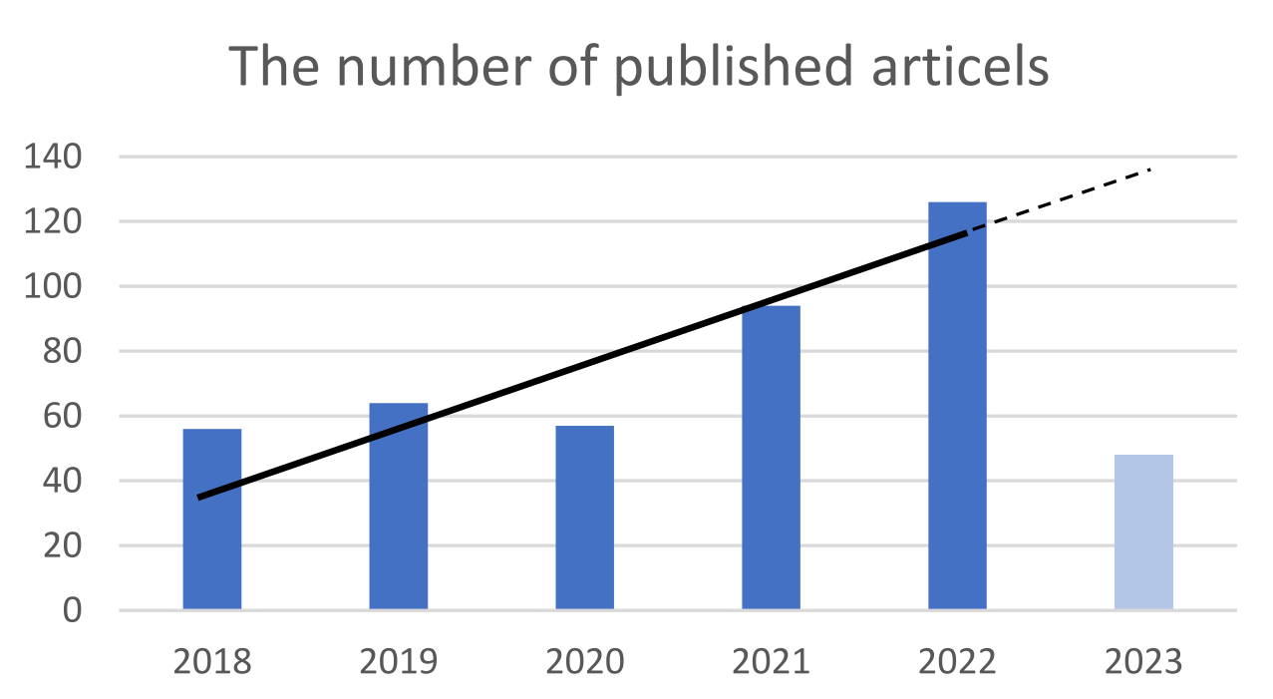
Conclusion

Slide 66
Conclusion
Need to provide an open-access and proper EEG database
Almost all the researchers applied their own database and it makes the comparison among the performance of studies very challenging
95% of the studies were conducted with fewer than 100 participants
Public medical imaging databases like ADNI or OASIS is a common practice in AD

Slide 67
Future Works
Longitudinal studies
Other neurological disorders,
Parkinson’s
epilepsy
stroke
Notes:
Longitudinal studies to assess whether EEG biomarkers can be used to trace the progress trajectory of AD or evaluate the efficacy of pharmacological/therapeutic interventions for AD patients.

Slide 68
Future Works
In transformer model
Add spatial attention module on the EEG channels
Study of new features that support the early detection of AD

Slide 69
Future Works
Multi modal EEG-based biomarker
Combined with neuroimaging techniques
Novel deep neural network architecture
Explains its reason for each output prediction

Slide 70
Thank You

